Slide 1
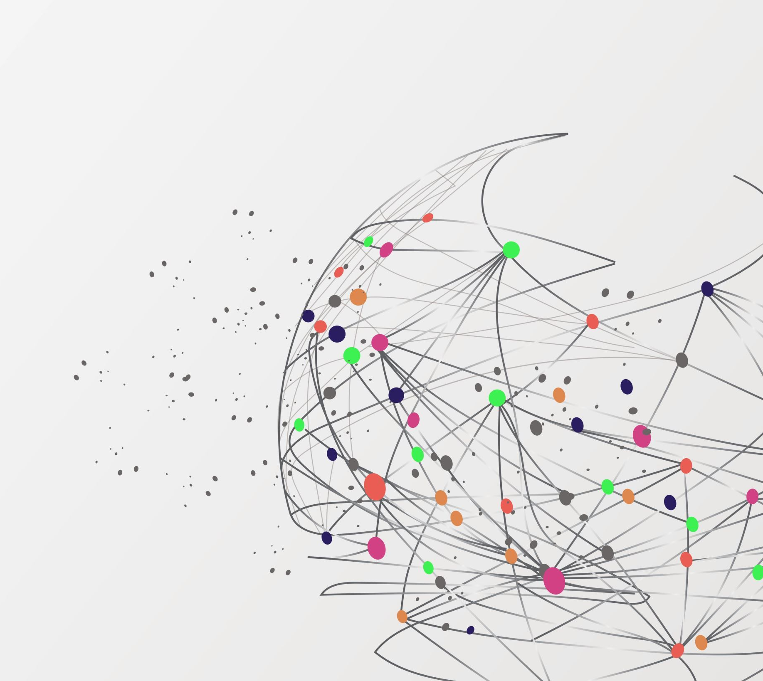
Stable Diffusion Image Generator on Hugging Face Spaces
EE267 Term Project Proposal
Author: Darshan Vipulkumar Jani
Affiliation: San Jose State University, Department of Electrical Engineering
Instructor: Prof. Chang Choo

Slide 2
Introduction
Stable Diffusion is a state-of-the-art artificial intelligence model designed for generating highly detailed and realistic images from textual prompts.
It specializes in synthesizing high-quality images based on textual descriptions, using deep learning techniques to interpret and visualize text with high fidelity.
The model combines the capabilities of advanced neural networks, including the CLIP model for text-image understanding and a UNet-based transformer for image diffusion and denoising.
Stable Diffusion is versatile, supporting a range of artistic and practical applications, from digital art creation to practical visualizations in diverse fields.

Slide 3
Primary Goal of the Project: To synthesize high-quality, contextually relevant images from textual prompts using advanced AI models.
Utilizing Advanced AI Models: Implementing the CLIP (Contrastive Language-Image Pretraining) model and a UNet-based diffusion algorithm for effective text-to-image synthesis.
Custom Loss Function: Designing a custom loss function to maximize image contrast, enhancing the visual quality and appeal of the generated images, and ensuring they stand out in terms of clarity and detail.
Style Incorporation and Diversity: Enhancing the versatility and appeal of the generated images by integrating a range of predefined style embeddings, such as birb, game, manga, sakimi, and space styles.
Objective

Slide 4

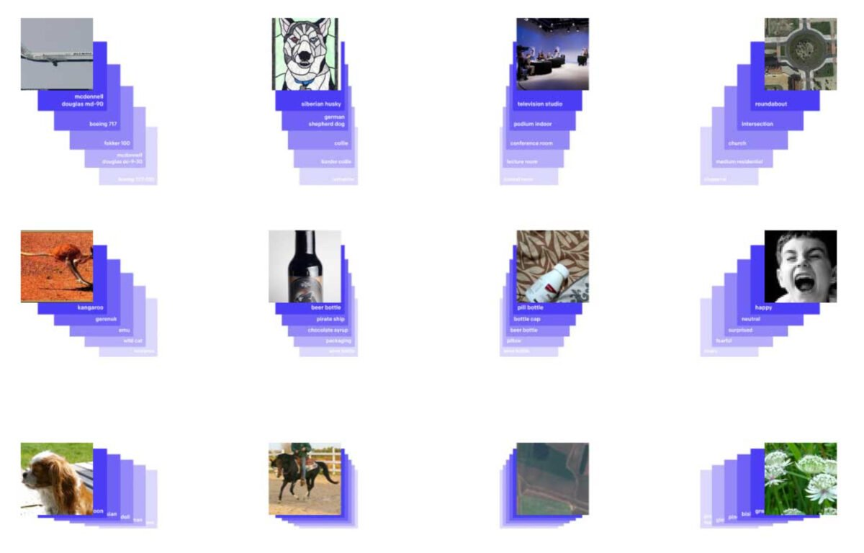
Related Work and Literature Review
BERT and Transformer Models:
Impact of BERT and transformer models on text embeddings and their effectiveness in image synthesis.
CLIP Model:
Development of the CLIP model by OpenAI, revolutionizing the understanding of text and image relationships.
UNet Architectures and Diffusion Models:
Application of UNet architectures in image generation and the significance of Variational Autoencoders (VAEs) in the diffusion process.
Transformers
CLIP

Slide 5
Core Components and Implementation
CLIP Model Utilization:
Utilizes the CLIP model to generate text embeddings from user inputs.
Precise interpretation of prompts for contextually relevant embeddings, leveraging CLIP's understanding of text-image relationships.
UNet-Based Diffusion Model:
Employs a UNet transformer diffusion model for image transformation.
Complex, iterative process of denoising and refining image details and textures.
Sophisticated handling of embedded styles and text prompts for accurate and artistically nuanced images.
Custom Style Embeddings Integration:
Incorporates distinct style embeddings, including birb, game, manga, sakimi, and space themes.
Extensive experimentation and fine-tuning to seamlessly blend styles with text-driven content.
Advanced Contrast Enhancement:
Develops a custom loss function aimed at maximizing image contrast.
Enhances visual quality by critically analyzing the image's gradients, accentuating edges and textures.

Slide 6
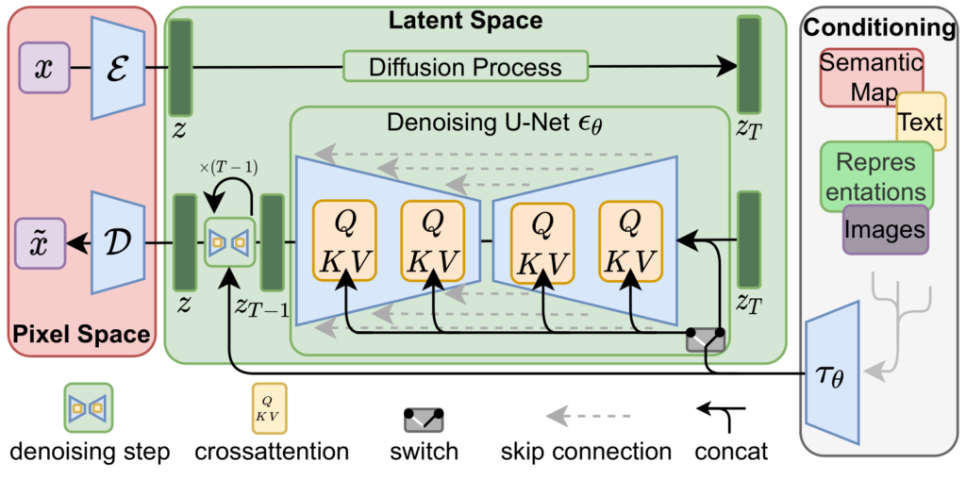
Stable Diffusion Model Architecture

Slide 7
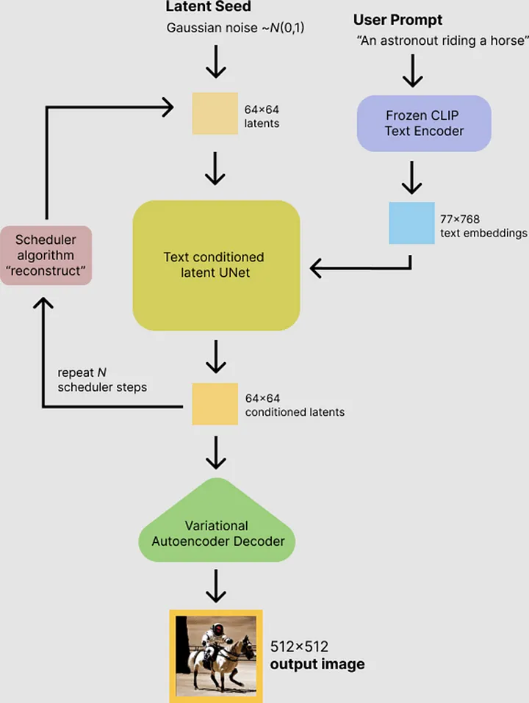
Methodology
Initiation with User Input:
"Process begins with users inputting textual prompts, setting the creative foundation for image generation."
CLIP Model for Text Embeddings:
"Utilizes the CLIP model to transform textual prompts into detailed text embeddings."
UNet Transformer for Image Synthesis:
"Employs a UNet-based transformer diffusion model, initiating with noise patterns and evolving into detailed images."
Iterative Refinement Process:
"Guided by combined text and style embeddings, the model refines image textures and contours in each iteration."

Slide 8

Deployment and User Interface
Hugging Face Spaces Deployment:
"Project deployed on Hugging Face Spaces, providing a robust platform for interactive real-world testing and user feedback."
User-Friendly Interface Design:
"Developed with a focus on user experience, featuring clear instructions, intuitive controls, and real-time feedback for seamless interaction."
Responsive and Efficient Backend:
"Optimized for a diverse user base with a responsive design across various devices, and a backend capable of handling multiple requests simultaneously for smooth and efficient processing."

Slide 9
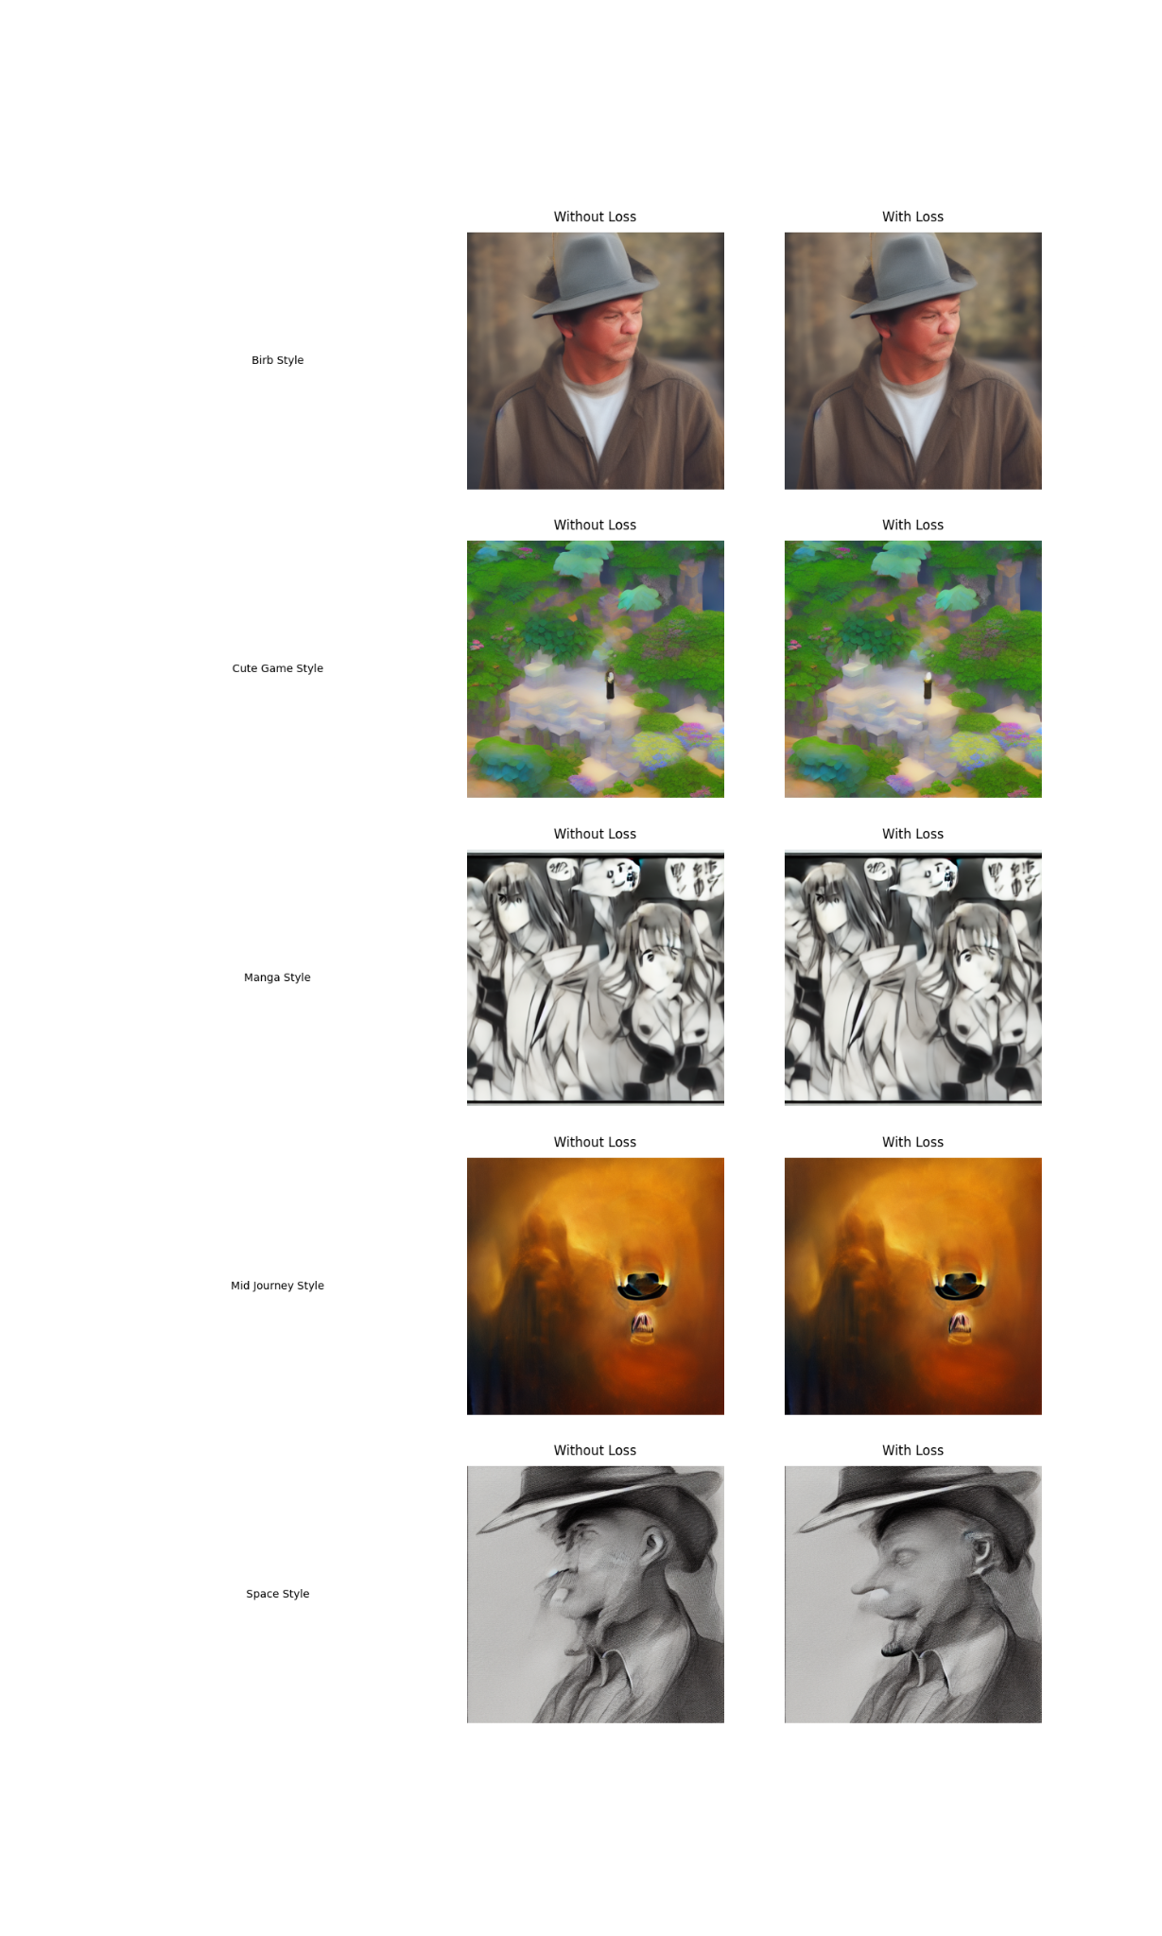
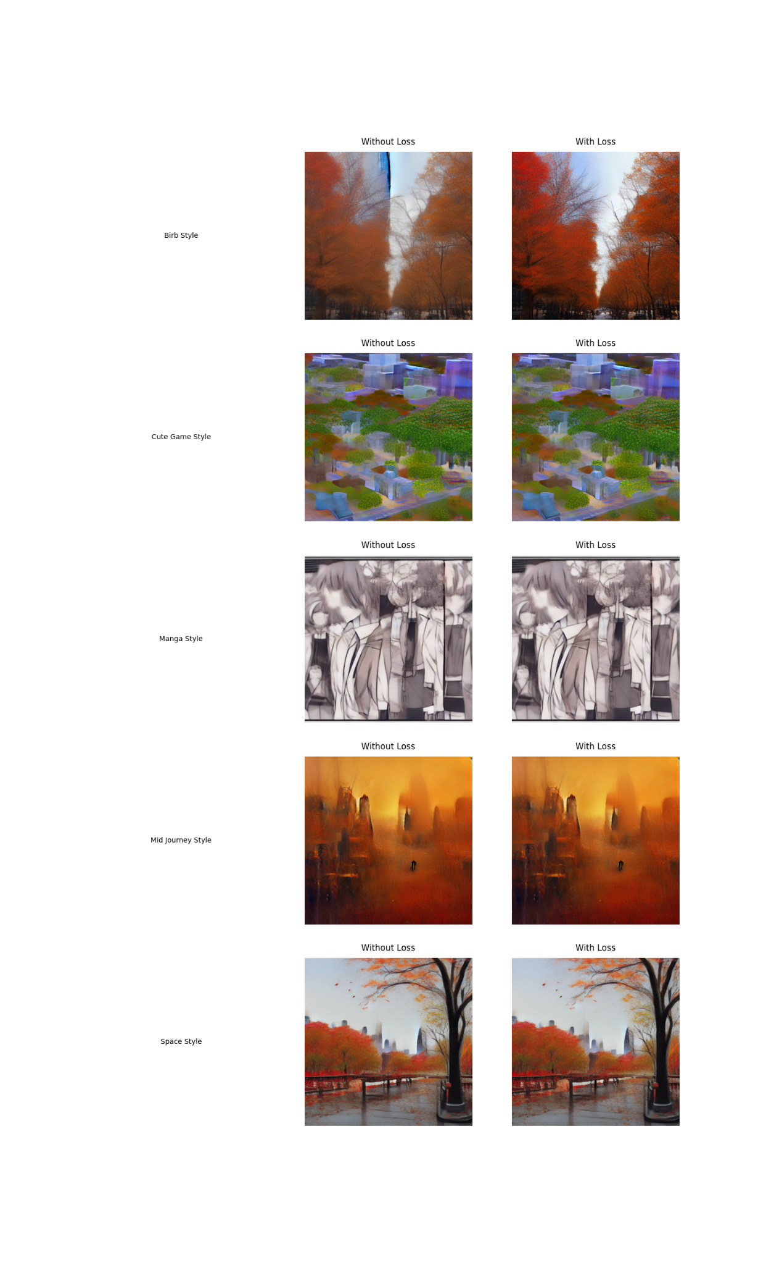
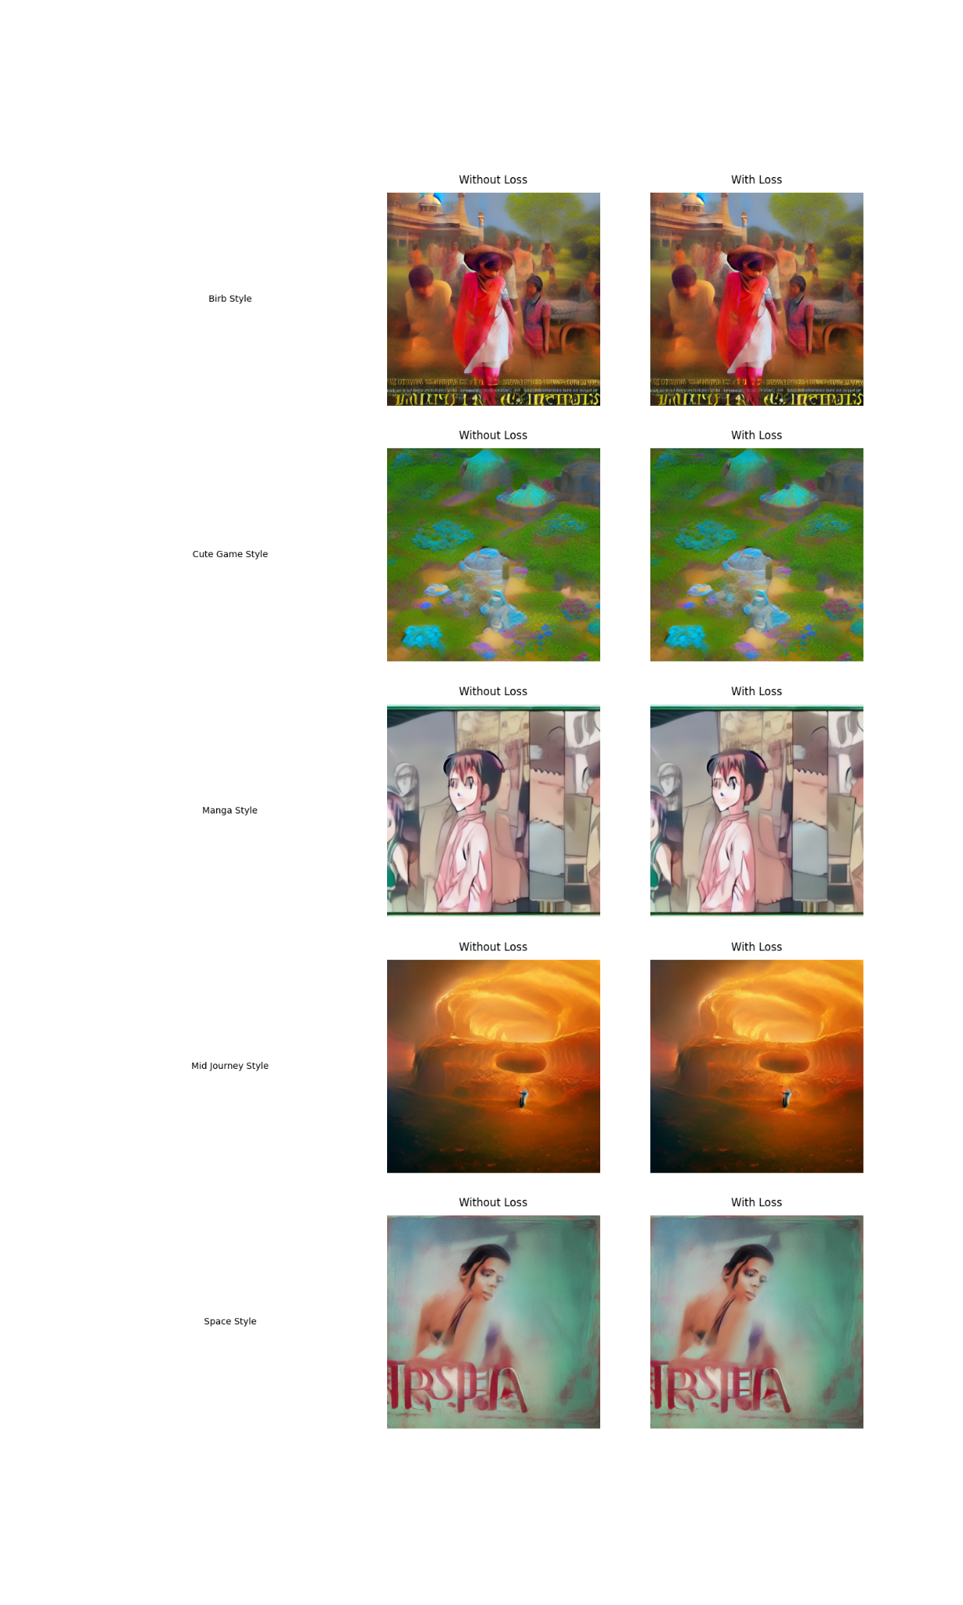
Results
A man wearing a hat
New York City in Fall
India in Summer

Slide 10
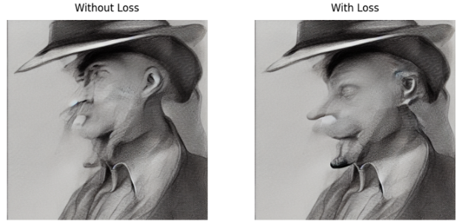
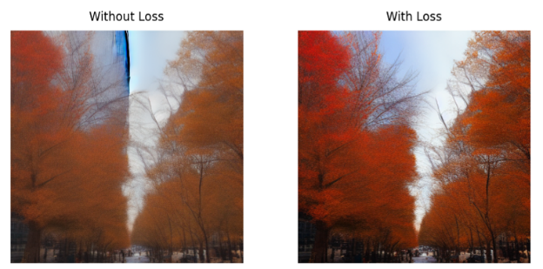
Comparison between Regular Loss Function (MSE) and Custom Loss (MSE + Contrast Loss)

Slide 11
Demo
https://huggingface.co/spaces/darshanjani/EE267_Stable_Diffusion

Slide 12

Conclusion and Future Work
Successful Integration: Successfully integrated CLIP and UNet models for generating contextually relevant, high-quality images from textual prompts.
Advancements in AI and Art: Contributed to the fields of computer vision and digital art by enhancing image quality with a custom contrast enhancement technique and diverse style embeddings.
Future Expansion: Plans to enhance style customization, improve image resolution, and expand text prompt capabilities for wider application and user engagement.

Slide 13
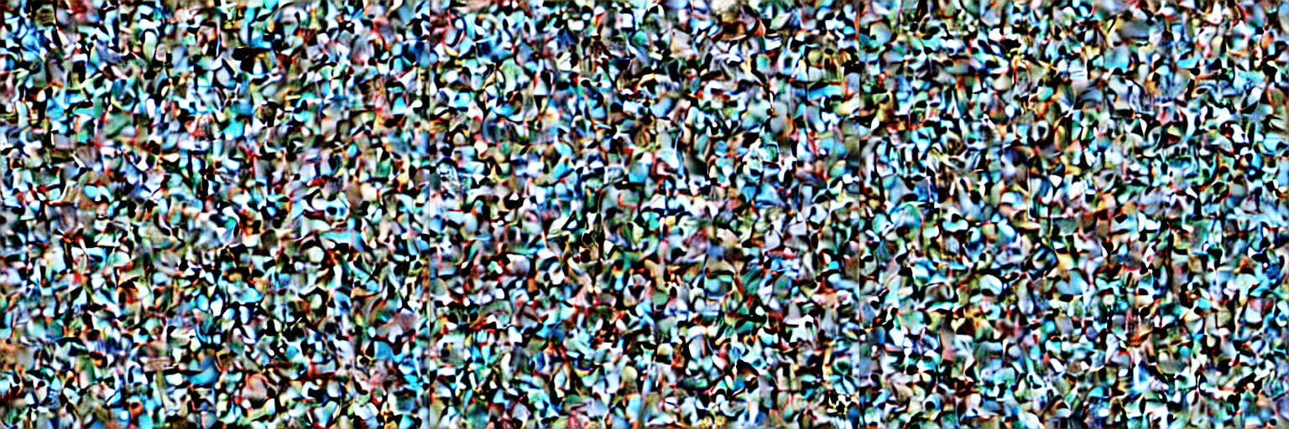
Thank You

